Slide 1
Advancing Kidney Health Worldwide. Together.

Slide 2
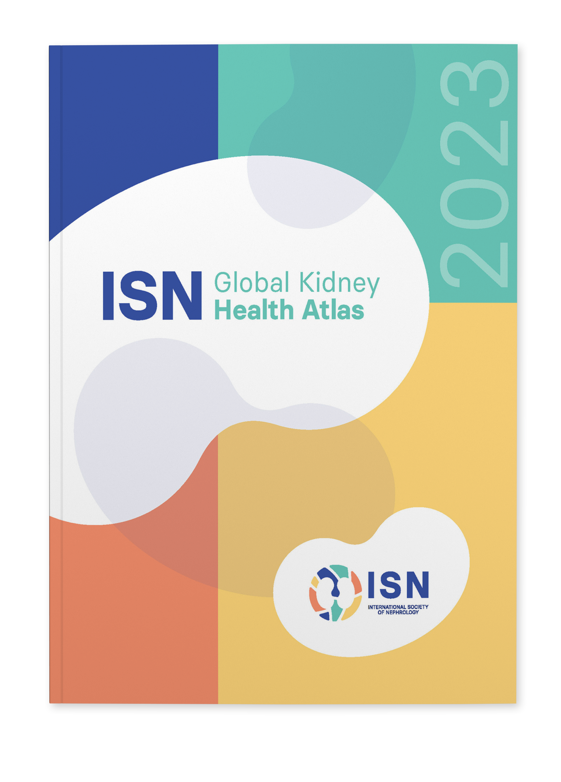
2023 ISN-GLOBAL
KIDNEY HEALTH ATLAS
(ISN-GKHA)
ISN NIS (NEWLY INDEPENDENT STATES)
AND RUSSIA REGION
www.theisn.org/global-atlas

Slide 3

Overview
Aim
Methods
Key Results

Slide 4
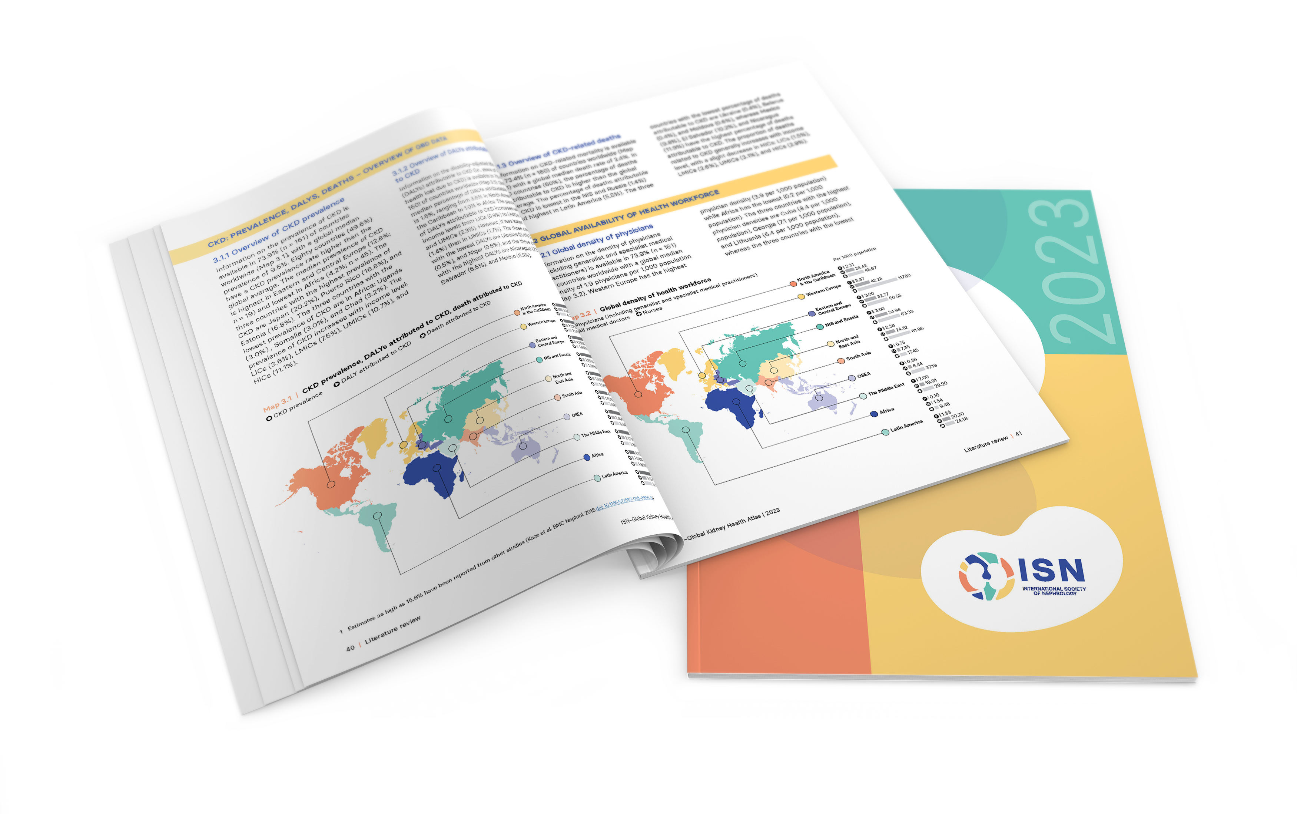
Aim of the ISN-Global Kidney Health Atlas
To understand, compare and monitor how different countries around the world detect, treat, monitor and advocate for people with kidney disease (AKI or CKD).
Key focus on availability, accessibility,
affordability and quality of ESKD care

Slide 5
ISN-Global Kidney Health Atlas Survey
2016
2018
2022
2026

Slide 6
Design and Scope
Online questionnary-based survey July – September 2022
  3 languages (English, French, Spanish)
  191 countries contacted
  ≥3 stakeholders per country
    National nephrology society leadership
    Healthcare policymakers
    Patients / patient advocacy groups
  Discrepancies resolved by follow-up conferences with regional board chairs and country nephrology leaders
Desk research (across countries and regions)
  Published and grey literature review
  Systematic review of kidney failure burden and outcomes
  Data extraction from major kidney registries (USRDS, ERA-EDTA) and relevant national registries where available
  Scoping review of KRT cost estimates
Notes:
REDCap Cloud. The questionnaire was peer reviewed for content validity and comprehensiveness before it was piloted with the 10 ISN regional boards to identify any logistical and feasibility issues (e.g., translation needs). Intensive follow-ups were conducted by email and telephone with ISN regional and national leaders to ensure complete and timely responses.
Data and reports published by the WHO Global Observatory, UN, World Bank, and OECD.
Both published and unpublished documents from international organizations/bodies and reports published by national governments on the organization and
delivery of ESKD.
Additional literature identified by key stakeholders (i.e., opinion leaders, national nephrology society leaders, ISN leaders) and through consultation with national nephrology societies and ISN regional boards.

Slide 7

Overall Survey Components

Slide 8
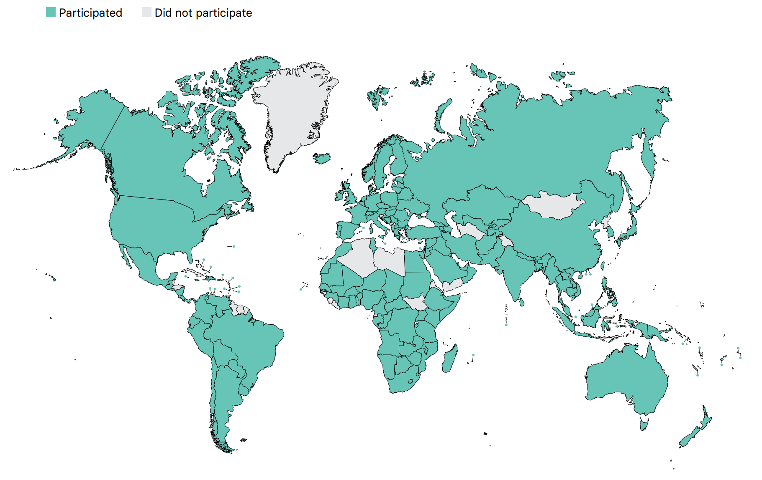
Overall ISN-GKHA response
167 countries (92%)
97% world’s population
329 individuals (63%) response
2 respondents/country
(IQR 2-3)
108 countries participated in the 2017, 2019, and 2023 GKHA surveys

Slide 9
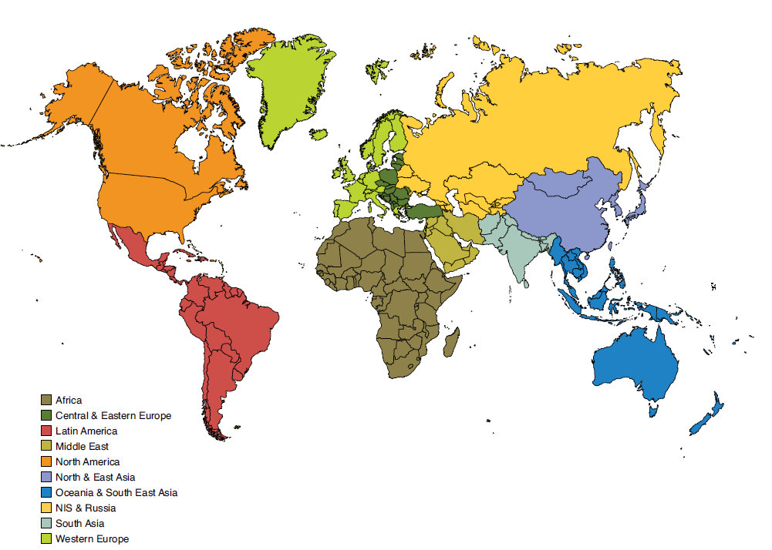
Results presented by ISN regions

Slide 10

ISN Region: NIS and Russia

Slide 11
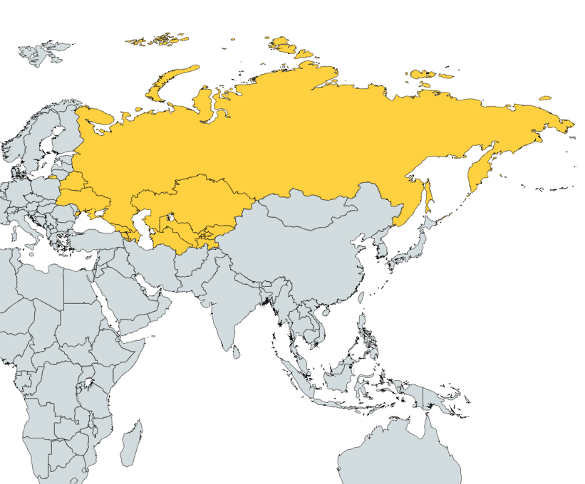
Demographics
Country | World bank ranking | Area (sq km) | Total population (2022) | GDP (PPP) ($ billion) | Total health expenditures (% of GDP)
Armenia | Upper-middle income | 29,743 | 3,000,756 | 43.5 | 11.3
Azerbaijan | Upper-middle income | 86,600 | 10,353,296 | 160.7 | 4
Belarus | Upper-middle income | 207,600 | 9,413,505 | 202.7 | 5.9
Georgia | Upper-middle income | 69,700 | 4,935,518 | 63.1 | 6.7
Kazakhstan | Upper-middle income | 2,724,900 | 19,398,331 | 545.0 | 2.8
Kyrgyz Republic | Lower-middle income | 199,951 | 6,071,750 | 35.4 | 4.5
Russian Federation | Upper-middle income | 17,098,242 | 142,000,000 | 4793.5 | 5.7
Tajikistan | Lower-middle income | 144,100 | 9,119,347 | 41.8 | 7.1
Ukraine | Lower-middle income | 603,550 | 43,528,136 | 588.4 | 7.1
Uzbekistan | Lower-middle income | 447,400 | 31,104,937 | 296.7 | 5.6
Responses were received from 10 of 11 countries NIS and Russia (91%) representing 98% of the region’s population.

Slide 12
Demographics
Country | World bank ranking | Area (sq km) | Total population (2022) | GDP (PPP) ($ billion) | Total health expenditures (% of GDP) | Total Health Spending per person | Government Health Spending per person | Out-of-pocket Health Spending per person
Armenia | Upper-middle income | 29,743 | 3,000,756 | 43.5 | 11.3 | 402 | 64 | 324
Azerbaijan | Upper-middle income | 86,600 | 10,353,296 | 160.7 | 4 | 157 | 51 | 104
Belarus | Upper-middle income | 207,600 | 9,413,505 | 202.7 | 5.9 | 344 | 244 | 85
Georgia | Upper-middle income | 69,700 | 4,935,518 | 63.1 | 6.7 | 339 | 147 | 156
Kazakhstan | Upper-middle income | 2,724,900 | 19,398,331 | 545.0 | 2.8 | 293 | 193 | 85
Kyrgyz Republic | Lower-middle income | 199,951 | 6,071,750 | 35.4 | 4.5 | 85 | 35 | 41
Russian Federation | Upper-middle income | 17,098,242 | 142,000,000 | 4793.5 | 5.7 | 559 | 350 | 197
Tajikistan | Lower-middle income | 144,100 | 9,119,347 | 41.8 | 7.1 | 57 | 15 | 37
Ukraine | Lower-middle income | 603,550 | 43,528,136 | 588.4 | 7.1 | 250 | 126 | 116
Uzbekistan | Lower-middle income | 447,400 | 31,104,937 | 296.7 | 5.6 | 90 | 37 | 48
‘ – ’ : data not reported/unavailable

Slide 13
CKD and its risk factors burden
Country | CKD Prevalence % (95% CI) | Death attributed to CKD % (95% CI) | DALYS attributed to CKD % (95% CI) | Obesity % (95% CI) | Increased BP % (95% CI) | Smoking % (95% CI)
Armenia | 14.89 (13.82 - 16.08) | 1.52 (1.45 - 1.59) | 1.29 (1.2 - 1.38) | 20.9 (16.3 - 25.7) | 25.5 (18.7 - 32.8) | 21.9 (19.9 - 23.9)
Azerbaijan | 11.26 (10.37 - 12.14) | 1.55 (1.33 - 1.68) | 1.32 (1.19 - 1.45) | 19.9 (15.3 - 24.9) | 24.5 (18.1 - 32.0) | 22.0 (19.7 - 24.2)
Belarus | 17.13 (15.82 - 18.65) | 0.4 (0.38 - 0.42) | 0.48 (0.44 - 0.53) | 26.6 (21.2 - 32.4) | 27.1 (20.3 - 34.2) | 27.6 (25.2 - 30.0)
Georgia | 12.55 (11.65 - 13.56) | 1.55 (1.46 - 1.64) | 1.49 (1.4 - 1.59) | 23.3 (18.4 - 28.5) | 26.3 (20.0 - 33.5) | 21.3 (19.1 - 23.5)
Kazakhstan | 10.42 (9.65 - 11.24) | 1.1 (1.05 - 1.16) | 0.98 (0.91 - 1.04) | 21.3 (17.1 - 25.7) | 27.1 (20.1 - 34.6) | 21.0 (19.1 - 22.8)
Kyrgyz Republic | 7.98 (7.38 - 8.63) | 1.41 (1.31 - 1.51) | 1.41 (1.27 - 1.54) | 15.4 (11.5 - 19.9) | 26.7 (20.3 - 33.6) | 17.4 (15.5 - 19.5)
Russian Federation | 19.23 (17.82 - 20.89) | 0.62 (0.61 - 0.63) | 0.67 (0.63 - 0.71) | 25.7 (21.7 - 30.1) | 27.2 (21.2 - 33.6) | 25.3 (23.3 - 27.2)
Tajikistan | 7.4 (6.86 - 8.0) | 1.34 (1.21 - 1.44) | 1.04 (0.94 - 1.14) | 12.6 (9.2 - 16.6) | 26.1 (18.9 - 34.2) | 9.9 (8.2 - 11.6)
Ukraine | 18.18 (16.81 - 19.64) | 0.42 (0.41 - 0.44) | 0.49 (0.46 - 0.53) | 26.1 (20.2 - 32.3) | 27.1 (20.7 - 34.2) | 25.4 (22.9 - 27.7)
Uzbekistan | 9.37 (8.68 - 10.12) | 1.75 (1.65 - 1.84) | 1.61 (1.48 - 1.74) | 15.3 (11.5 - 19.8) | 25.6 (19.3 - 32.4) | 8.8 (7.4 - 10.3)
Abbreviations: CKD (Chronic Kidney Disease), DALYS (disability-adjusted life years), BP (blood pressure), CI (confidence interval)
Data source: GBD study database (http://www.healthdata.org/gbd), WHO data observatory (https://www.who.int/gho/en/)

Slide 14
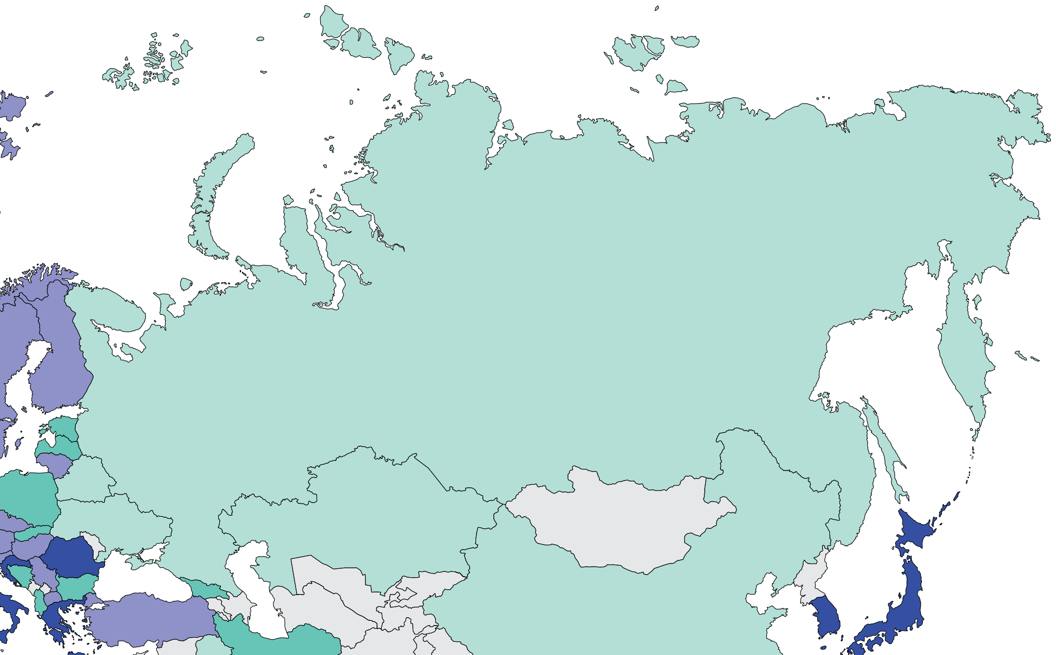
Burden of kidney failure
Prevalence of treated kidney failure
Country | Treated kidney failure |  | Chronic dialysis (HD+PD) |  | Chronic HD |  | Chronic PD
 | Incidence | Prevalence | Incidence | Prevalence | Incidence | Prevalence | Incidence | Prevalence
Armenia | - | - | - | - | - | - | - | 0
Azerbaijan | - | - | - | - | - | - | - | 0
Belarus | 93 | 417 | - | 221.3 | - | 194.4 | - | 26.9
Georgia | 203 | 713 | - | 179.3 | - | 162 | - | 17.3
Kazakhstan | - | 211 | - | 186 | - | - | - | -
Kyrgyz Republic | - | - | - | - | - | - | - | -
Russian Federation | 88 | 411 |  | 334 |  | 113.2 |  | 11.7
Tajikistan | - | - | - | - | - | - | - | -
Ukraine | 40 | 244 | - | 209 | - | 66.4 | - | 10.8
Uzbekistan | - | - | - | - | - | - | - | 0
Treated kidney failure: all dialysis + transplant
* pmp (per million population)
Data source: ERA-EDTA Registry Annual Report 2019, Jain et al. (JASN) 2012, 2019 USRDS Annual Data Report
‘ – ’ : data not reported/unavailable

Slide 15
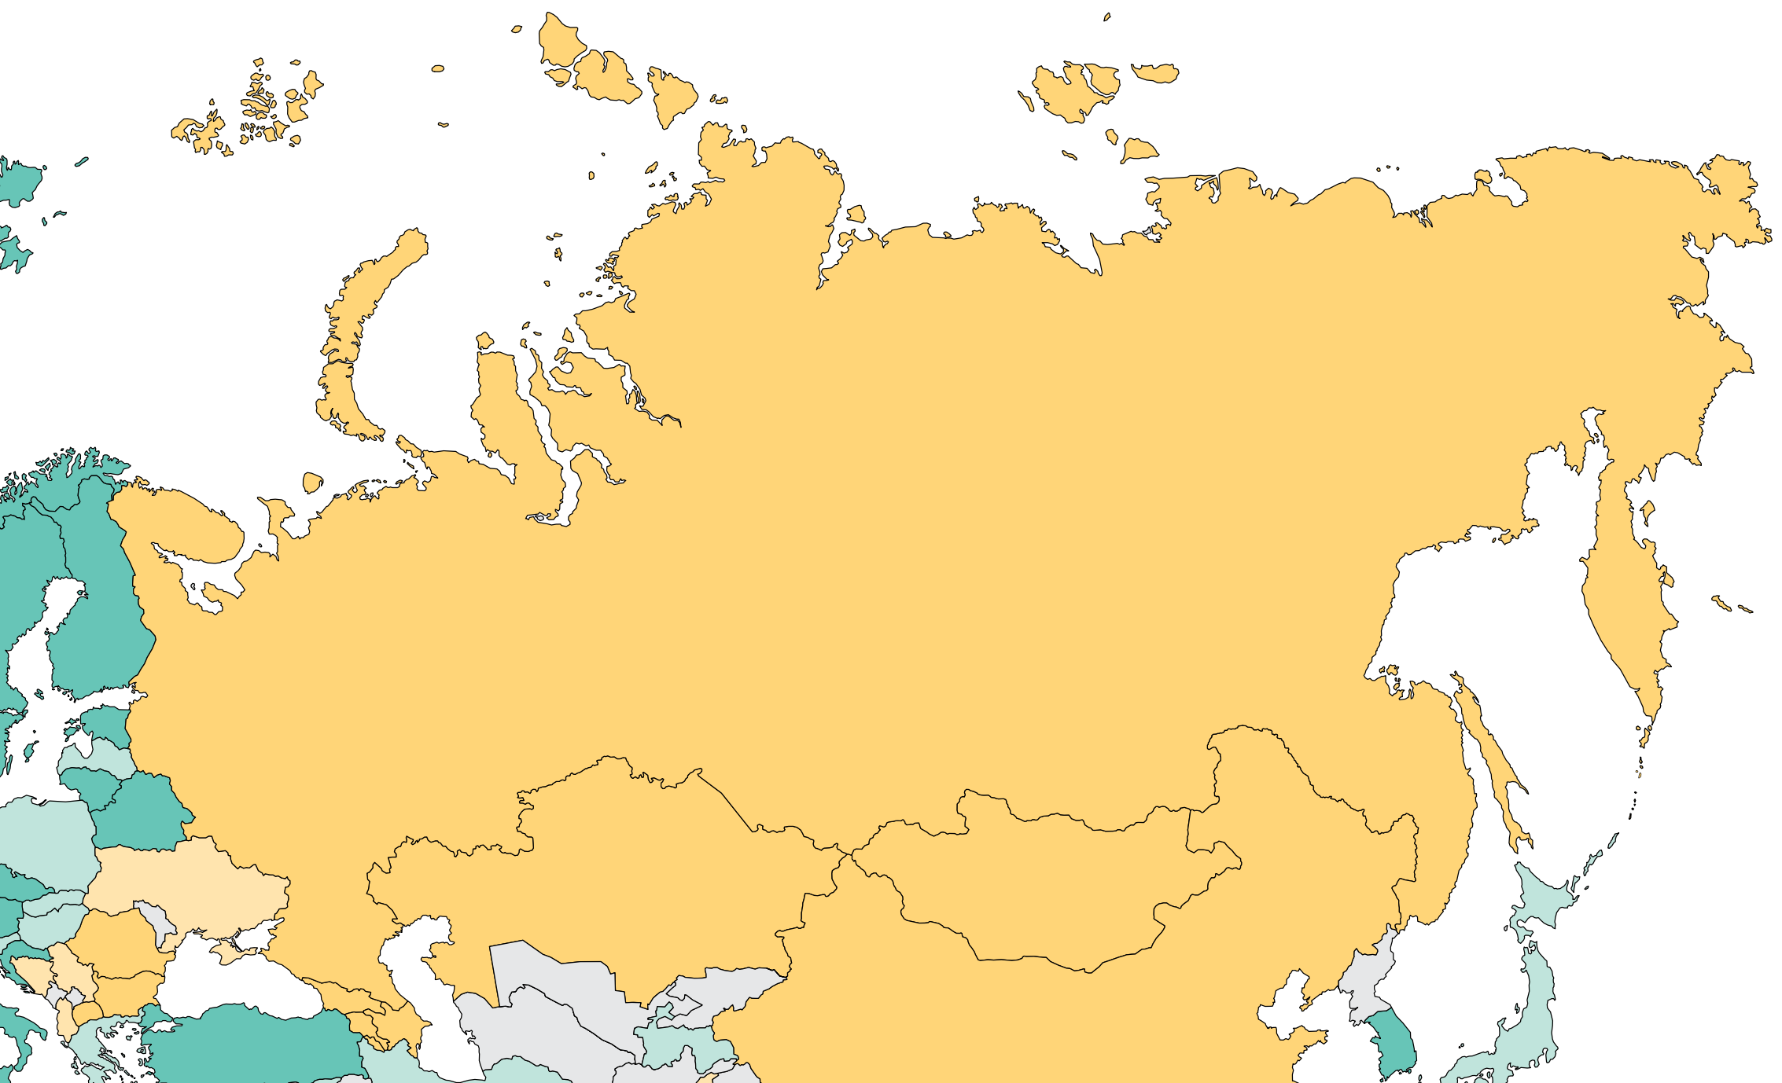
Burden of kidney failure (cont’d)
Incidence of kidney transplantation
Country | Kidney transplantation
 | Incidence overall | Prevalence overall | Incidence of deceased donor | Incidence of living donor | Incidence of pre-emptive
Armenia | 5.33 | - | 0 | 5.33 | -
Azerbaijan | 9.59 | - | 0 | 9.59 | -
Belarus | 35.74 | - | 34.89 | 0.85 | -
Georgia | 5.5 | - | 0 | 5.5 | -
Kazakhstan | 11.43 | 25 | 2.36 | 9.07 | -
Kyrgyz Republic | - | - | - | - | -
Russian Federation | 7.7 | 69 | 6.63 | 1.08 | -
Tajikistan | 17.21 | - | 0 | 17.21 | -
Ukraine | 2.27 | 33 | 0.46 | 1.81 | -
Uzbekistan | - | - | - | - | -
* pmp (per million population)
Data source: GODT database (http://www.transplant-observatory.org/data-charts-and-tables/), 2019 USRDS Annual Data Report
‘ – ’ : data not reported/unavailable

Slide 16
Annual cost of kidney replacement therapy components
Country | Hemodialysis | Peritoneal dialysis | Kidney Transplant (First year) | Kidney Transplant (later years) | HD/PD cost ratio
Armenia | 6375 | - | 8950 | 4150 | -
Azerbaijan | - | - | - | - | -
Belarus | 5603 | 7503 | - | - | 0.75
Georgia | 6494 | 11122 | 9824 | 1240 | 0.58
Kazakhstan | 10421 | - | 7816 | - | -
Kyrgyz Republic | - | - | - | - | -
Russian Federation | 16447 | 26126 | - | - | 0.63
Tajikistan | - | - | - | - | -
Ukraine | 15269 | 16572 | - | - | 0.92
Uzbekistan | - | - | - | - | -
*Cost is in $US 2021
Abbreviations: HD (hemodialysis), PD (peritoneal dialysis)
Data source: Babloyan et al. (2021), Kolesnyk et al. (2021), Saparbay et al. (2022), Tataradze et al. (2016), van der Tol et al. (2019)
‘ – ’ : data not reported/unavailable

Slide 17
Country level scorecard
Country |  | Availability of KRT |  |  | Availability of CKM |  |  | Funding for Medications |  |  | Availability of Distribution of Registry |  |  |  | Advocacy Group |  |  | Nephrology Workforce (PMP)
 |  | HD | PD | Kidney transplantation | Shared decision | Choice restricted (limited) | Choice restricted (not limited) | CKD | Dialysis | Kidney transplantation | CKD | Dialysis | Kidney transplantation | AKI | CKD | AKI | RRT | Nephrologist | Nephrologist trainees
Armenia | 2019 |  |  |  |  |  |  |  |  |  |  |  |  |  |  |  |  | 3.29 | 1.65
 | 2023 |  |  |  |  |  |  |  |  |  |  |  |  |  |  |  |  | 6.66 | 1.67
Azerbaijan | 2019 |  |  |  |  |  |  |  |  |  |  |  |  |  |  |  |  | 18.41 | 49.77
 | 2023 |  |  |  |  |  |  |  |  |  |  |  |  |  |  |  |  |  | 1.93
Belarus | 2019 |  |  |  |  |  |  |  |  |  |  |  |  |  |  |  |  | 26.24
 | 2023 |  |  |  |  |  |  |  |  |  |  |  |  |  |  |  |  | 21.25 | 0.42
Georgia | 2019 |  |  |  |  |  |  |  |  |  |  |  |  |  |  |  |  | 28.42 | 3.25
 | 2023 |  |  |  |  |  |  |  |  |  |  |  |  |  |  |  |  | 31.20 | 3.24
Kazakhstan | 2019 |  |  |  |  |  |  |  |  |  |  |  |  |  |  |  |  | 13.34 | 1.60
 | 2023 |  |  |  |  |  |  |  |  |  |  |  |  |  |  |  |  | 12.89 | 1.55
Kyrgyz Republic | 2019
 | 2023 |  |  |  |  |  |  |  |  |  |  |  |  |  |  |  |  | 4.94 | 1.98
Russian Federation | 2019 |  |  |  |  |  |  |  |  |  |  |  |  |  |  |  |  | 15.48 | 0.70
 | 2023 |  |  |  |  |  |  |  |  |  |  |  |  |  |  |  |  | 24.64 | 0.35
Tajikistan | 2019 |  |  |  |  |  |  |  |  |  |  |  |  |  |  |  |  | 1.74 | 0.46
 | 2023 |  |  |  |  |  |  |  |  |  |  |  |  |  |  |  |  | 3.51 | 0.77
Ukraine | 2019 |  |  |  |  |  |  |  |  |  |  |  |  |  |  |  |  | 9.94 | 0.11
 | 2023 |  |  |  |  |  |  |  |  |  |  |  |  |  |  |  |  |  | 0.34
Uzbekistan | 2019
 | 2023 |  |  |  |  |  |  |  |  |  |  |  |  |  |  |  |  | 0.00 | 0.96
Yes
No
N/A
Abbreviations
KRT: kidney replacement therapy
CKM: conservative kidney management
CKD: chronic kidney disease
AKI: acute kidney injury
RRT: renal replacement therapy

Slide 18
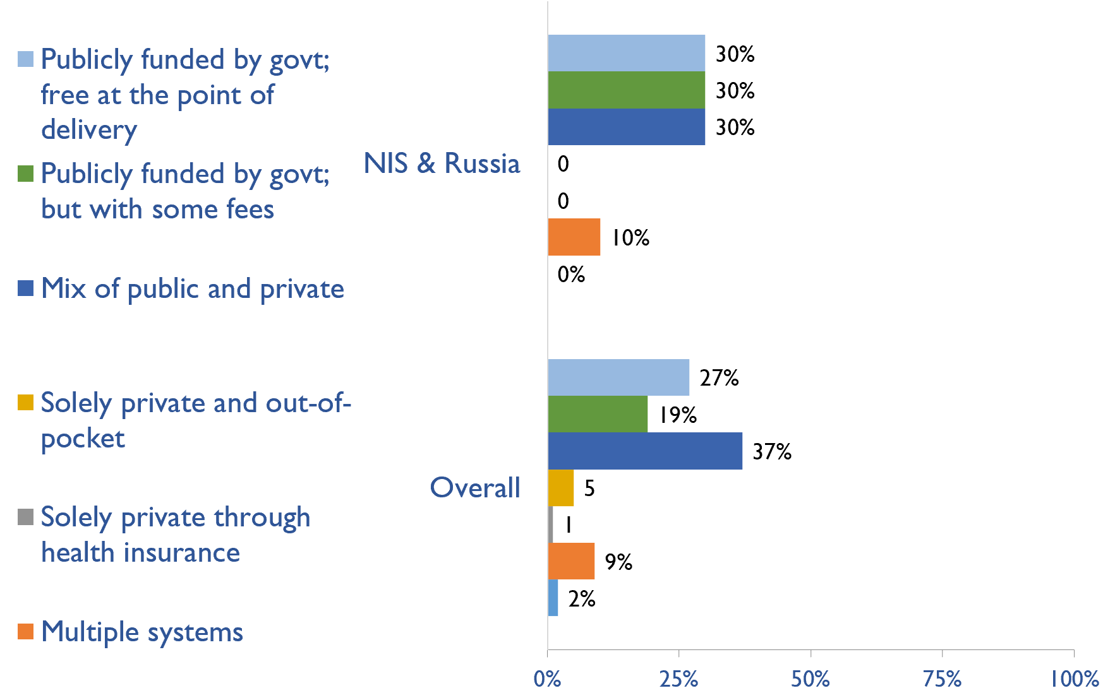
Funding for non-dialysis CKD
Country | Publicly funded by govt; free at the point of delivery | Publicly funded by govt but with some fees at the point of delivery | Mix of public and private funding systems | Solely private and out-of-pocket | Solely private through health insurance | Multiple systems | Other
Armenia |  |  |  |  |  | X
Azerbaijan |  |  | X
Belarus | X
Georgia |  |  | X
Kazakhstan | X
Kyrgyz Republic |  | X
Russian Federation | X
Tajikistan |  | X
Ukraine |  |  | X
Uzbekistan |  | X
X : Yes

Slide 19
Funding for kidney replacement therapy (KRT)
Country | Publicly funded (free) |  |  |  | Publicly funded (some fees) |  |  |  | Mixed |  |  |  | Solely private (out-of-pocket) |  |  |  | Solely private (health insurance) |  |  |  | Multiple systems |  |  |  | N/A |  |  |  | Other
 | AKI | HD | PD | TX | AKI | HD | PD | TX | AKI | HD | PD | TX | AKI | HD | PD | TX | AKI | HD | PD | TX | AKI | HD | PD | TX | AKI | HD | PD | TX | AKI | HD | PD | TX
Armenia | X | X |  | X |  |  |  |  |  |  |  |  |  |  |  |  |  |  |  |  |  |  |  |  |  |  | X
Azerbaijan |  | X | X |  |  |  |  |  |  |  |  |  | X |  |  | X
Belarus | X | X | X | X
Georgia |  |  |  |  | X | X | X | X
Kazakhstan | X | X | X | X
Kyrgyz Republic |  | X | X |  | X |  |  |  |  |  |  |  |  |  |  | X
Russian Federation | X | X | X | X
Tajikistan |  |  |  |  | X |  |  | X |  |  |  |  |  | X | X
Ukraine |  |  |  |  |  |  |  | X | X | X | X
Uzbekistan | X |  |  |  |  |  |  |  |  | X |  | X |  |  |  |  |  |  |  |  |  |  |  |  |  |  | X
X : Yes
Abbreviations: AKI (Acute kidney injury), HD (hemodialysis), PD (peritoneal dialysis), TX (transplant medications)

Slide 20
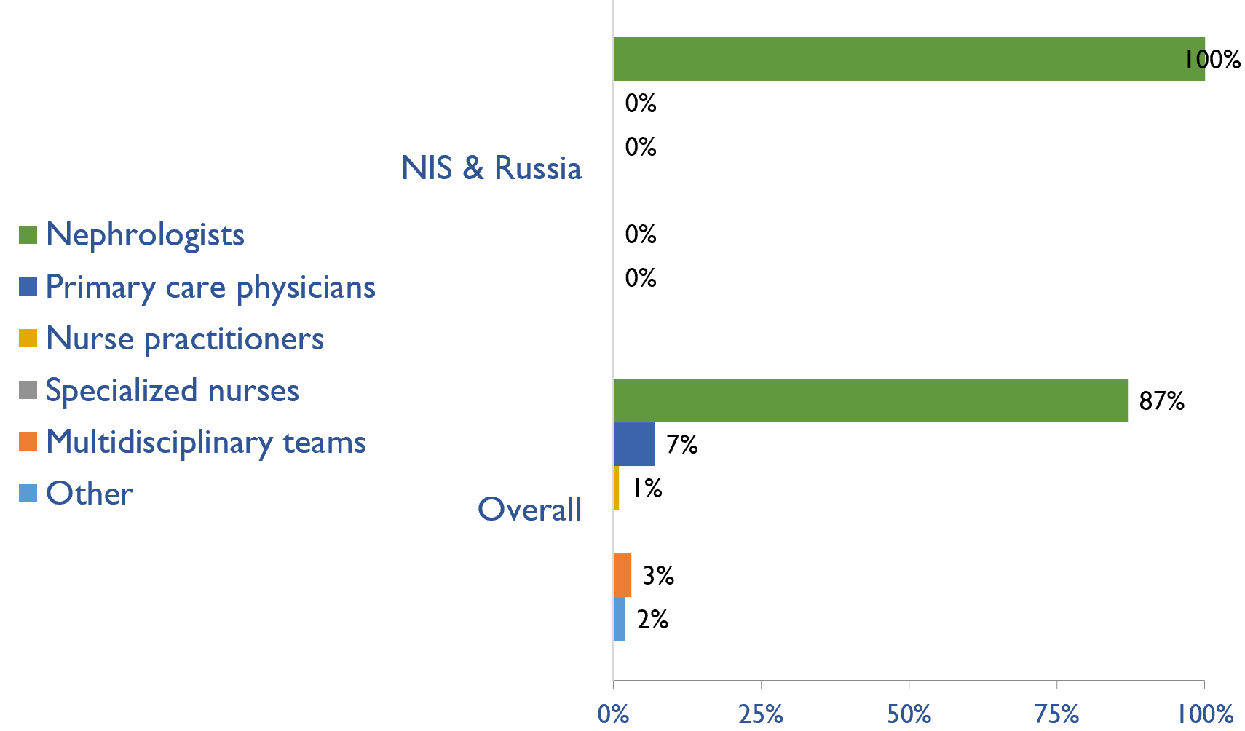
Providers primarily responsible for kidney failure care
Country | Nephrologists | Primary care physicians | Nurse practitioners or specialized nurses | Multidisciplinary teams | Health officers/ extension workers | Other
Armenia | X
Azerbaijan | X
Belarus | X
Georgia | X
Kazakhstan | X
Kyrgyz Republic | X
Russian Federation | X
Tajikistan | X
Ukraine | X
Uzbekistan | X
X : Yes

Slide 21
Shortage of kidney failure care providers
Country | Nephrologists | Pediatric nephrologists | Transplant surgeons | Surgeons (HD access) | Surgeons (PD access) | Dietitians | Laboratory technicians | Radiologists (ultrasound) | Vascular access coordinators
Armenia
Azerbaijan
Belarus
Georgia
Kazakhstan
Kyrgyz Republic
Russian Federation
Tajikistan
Ukraine
Uzbekistan
No shortage
Shortage

Slide 22
Shortage of kidney failure care providers
Country | Counsellors/ psychologists | Transplant coordinators | Dialysis nurses | Renal nurses | Dialysis technicians | Social workers | Palliative care physicians | Kidney supportive care nurses | No shortage
Armenia
Azerbaijan
Belarus
Georgia
Kazakhstan
Kyrgyz Republic
Russian Federation
Tajikistan
Ukraine
Uzbekistan
No shortage
Shortage

Slide 23
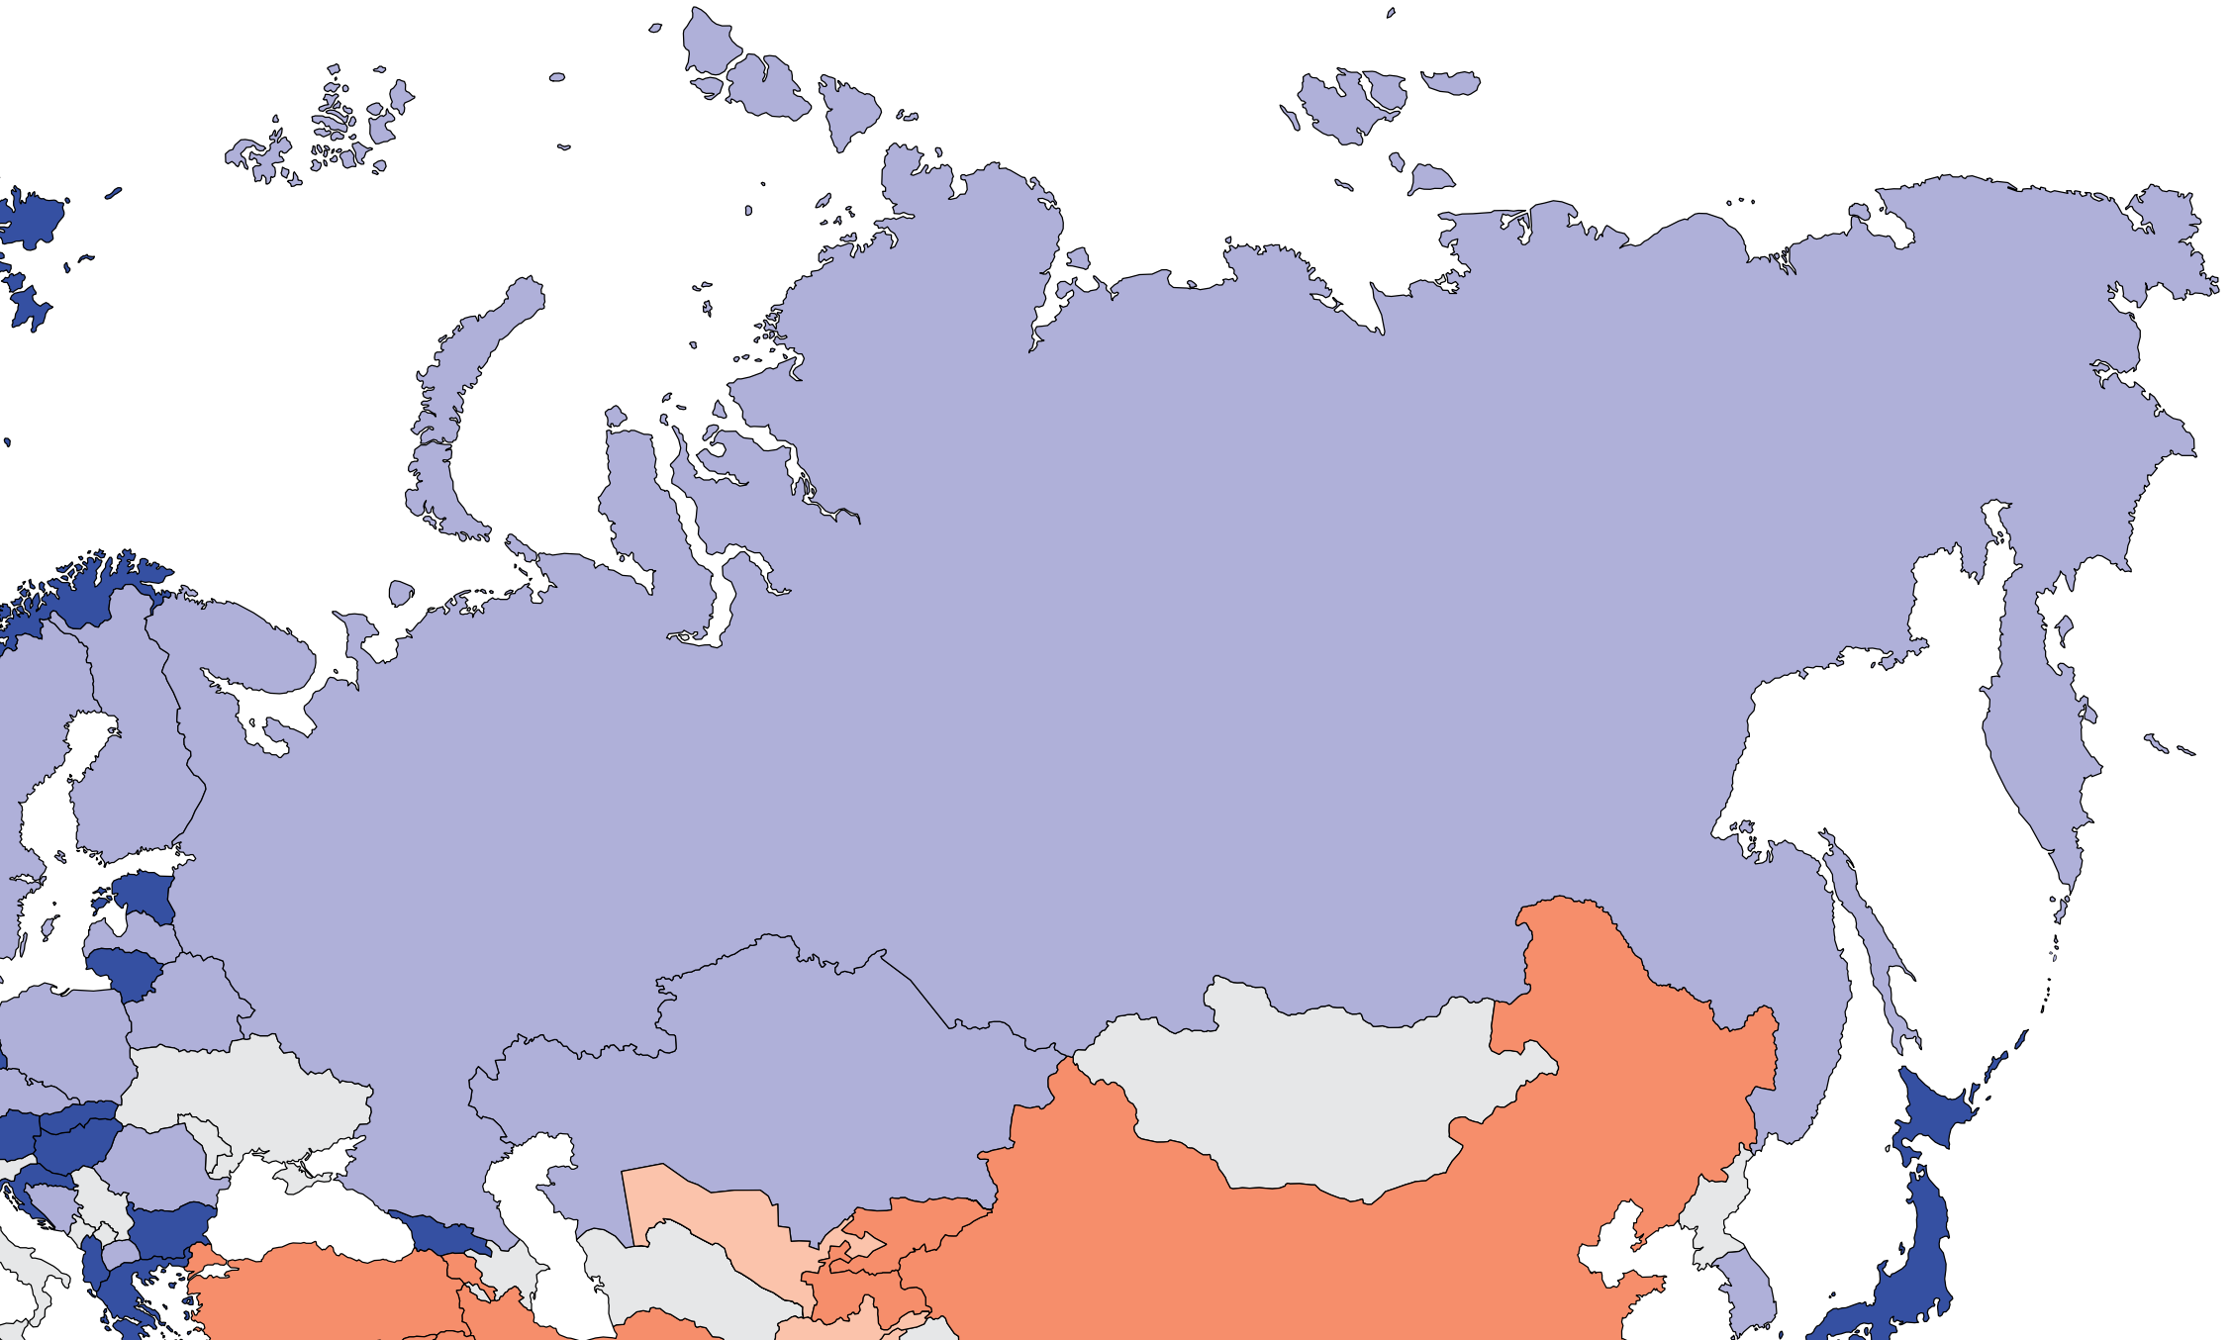
Prevalence of nephrologists and trainees
Nephrologists
Country | Nephrologists PMP | Nephrology trainees PMP
Armenia | 6.66 | 1.67
Azerbaijan | - | 1.93
Belarus | 21.25 | 0.42
Georgia | 31.20 | 3.24
Kazakhstan | 12.89 | 1.55
Kyrgyz Republic | 4.94 | 1.98
Russian Federation | 24.64 | 0.35
Tajikistan | 3.51 | 0.77
Ukraine | - | 0.34
Uzbekistan | 0.00 | 0.96
‘ – ’ : data not reported/unavailable
**After data analysis, we were informed that Uzbekistan has about 70 nephrologists (60 adults and 10 paediatric nephrologists)

Slide 24
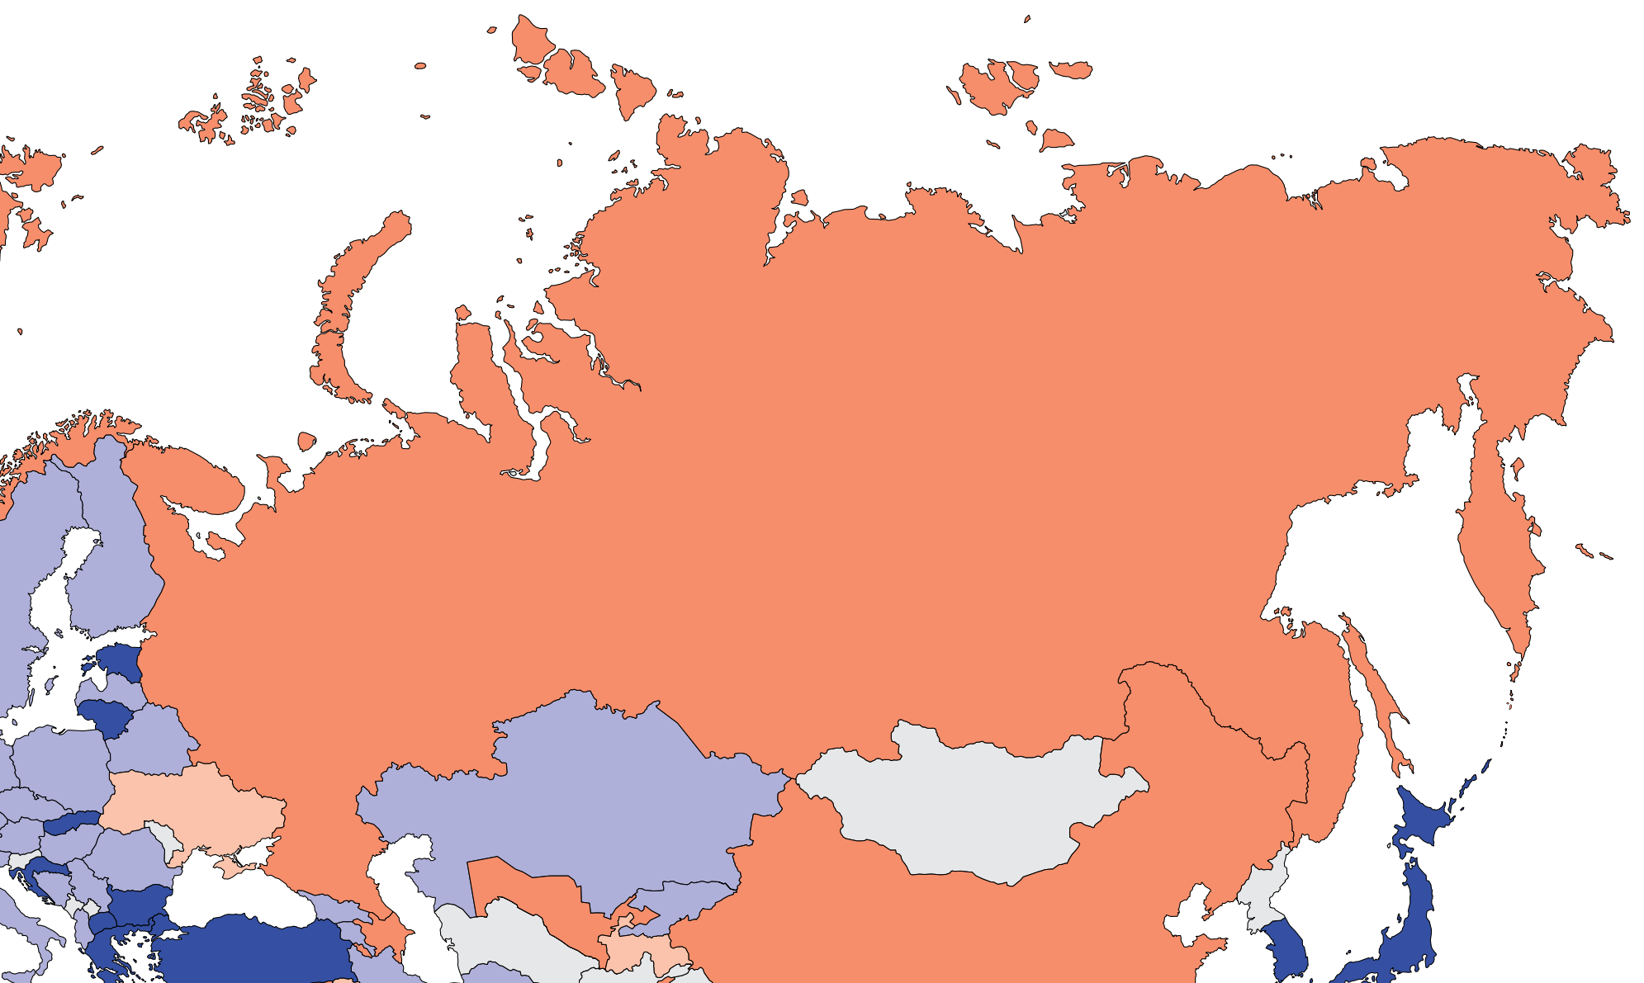
Capacity for chronic dialysis (HD)
Chronic HD centers
Country | Chronic HD Centres PMP
Armenia | 5.00
Azerbaijan | 3.86
Belarus | 5.42
Georgia | 6.69
Kazakhstan | 6.13
Kyrgyz Republic | 5.76
Russian Federation | 4.60
Tajikistan | 0.44
Ukraine | 0.92
Uzbekistan | 2.09
Chronic HD services are available in all countries of the region
The NIS and Russia average of HD treatment centers is 4.09 pmp
‘ – ’ : data not reported/unavailable

Slide 25
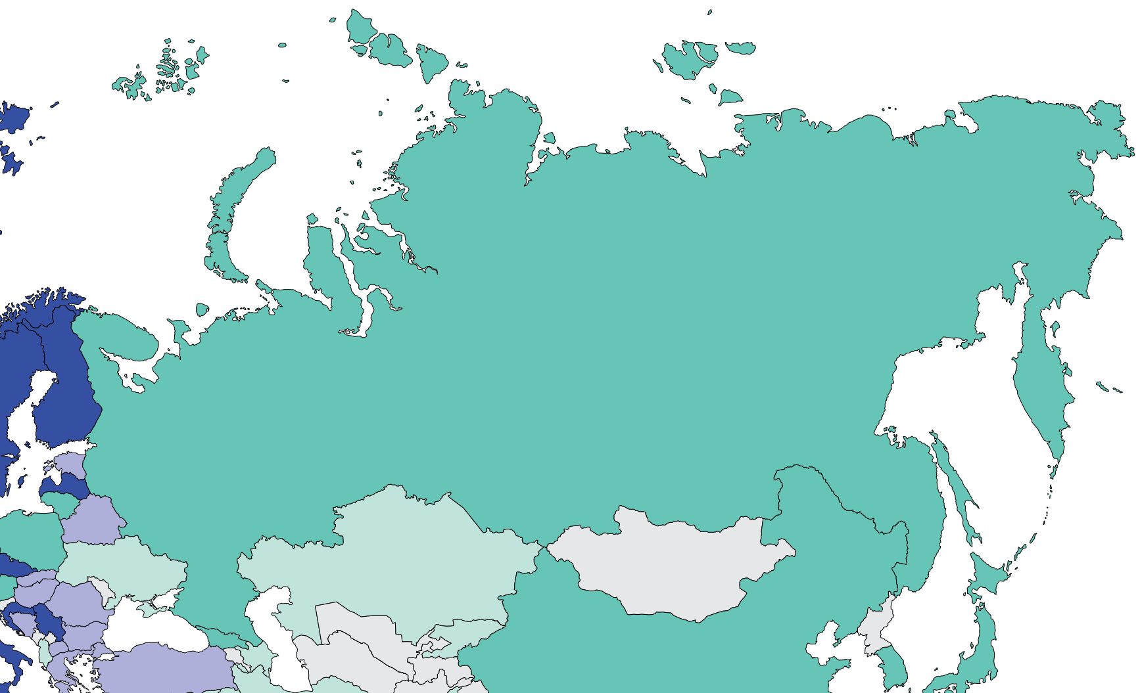
Capacity for chronic dialysis (PD)
Chronic PD centers
Country | Chronic PD Centres PMP
Armenia | -
Azerbaijan | 0.29
Belarus | 1.91
Georgia | 0.61
Kazakhstan | 0.26
Kyrgyz Republic | 0.16
Russian Federation | 0.94
Tajikistan | -
Ukraine | 0.46
Uzbekistan | -
Chronic PD services are available in 7 (70%) countries of the region
The NIS and Russia average of PD treatment centers is 0.66 pmp
‘ – ’ : data not reported/unavailable

Slide 26
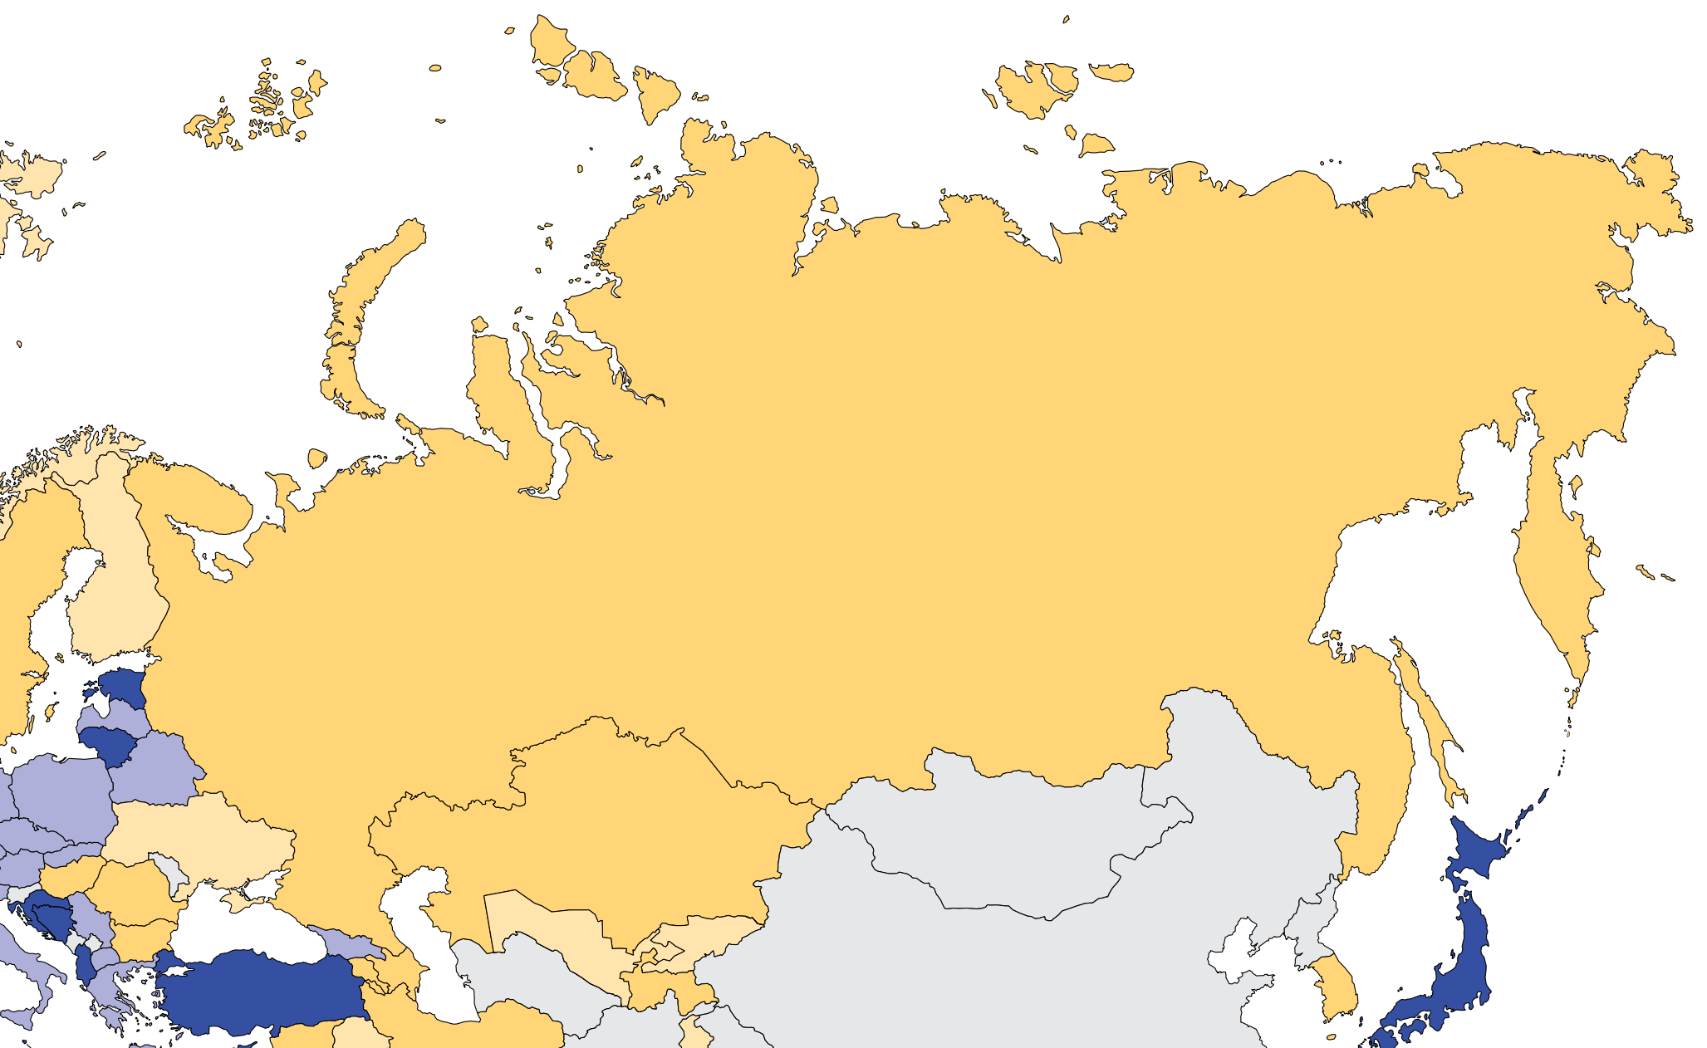
Capacity for Kidney Transplantation
Kidney transplantation centers
Country | Kidney Transplantation availability | Transplant centers PMP
Armenia | X | 0.33
Azerbaijan | X | 0.29
Belarus | X | 0.64
Georgia | X | 0.61
Kazakhstan | X | 0.26
Kyrgyz Republic | X | 0.16
Russian Federation | X | 0.32
Tajikistan | X | 0.22
Ukraine | X | 0.18
Uzbekistan | X | 0.10
Kidney transplantation services are available in all countries of the region
The NIS and Russia average of Kidney transplantation centers is 0.31 pmp
X : Yes
‘ – ’ : data not reported/unavailable

Slide 27
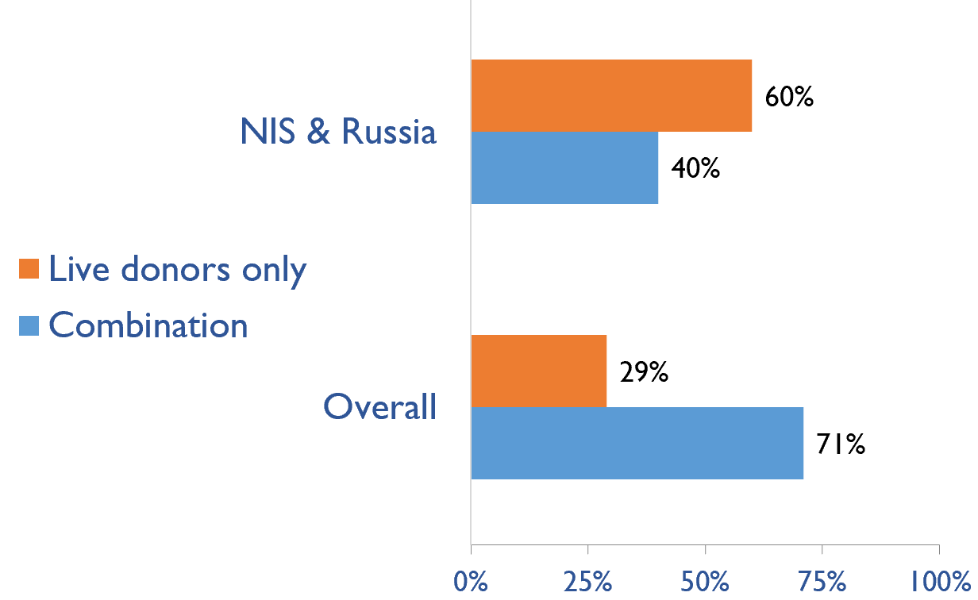
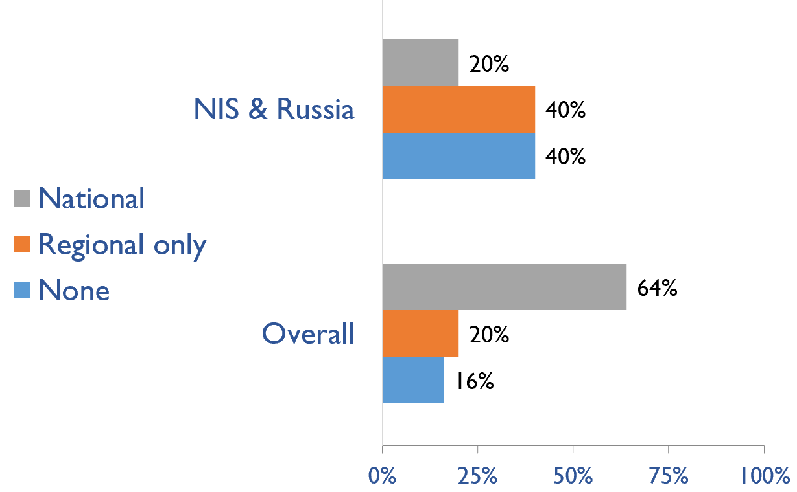
Capacity for Kidney Transplantation (cont’d)
Transplant donor type
Transplant waitlist
Country | Donor type |  | Transplant waitlist
 | Live donors only | Combination | National | Regional only | None
Armenia | X |  |  |  | X
Azerbaijan | X |  |  |  | X
Belarus |  | X | X
Georgia | X |  |  |  | X
Kazakhstan |  | X |  | X
Kyrgyz Republic | X |  |  | X
Russian Federation |  | X |  | X
Tajikistan | X |  |  |  | X
Ukraine |  | X |  | X
Uzbekistan | X |  | X
X : Yes

Slide 28
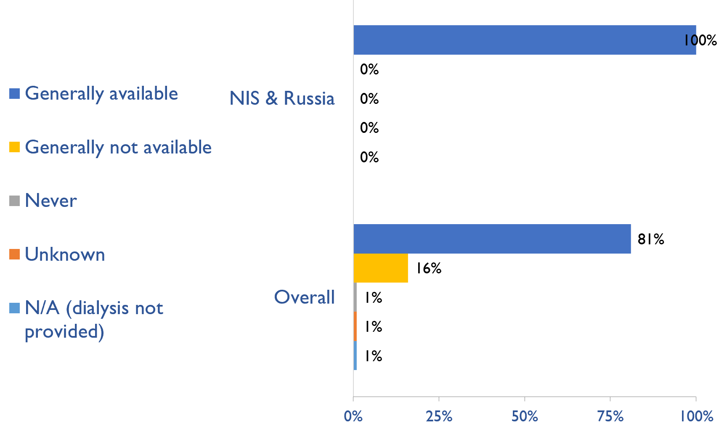
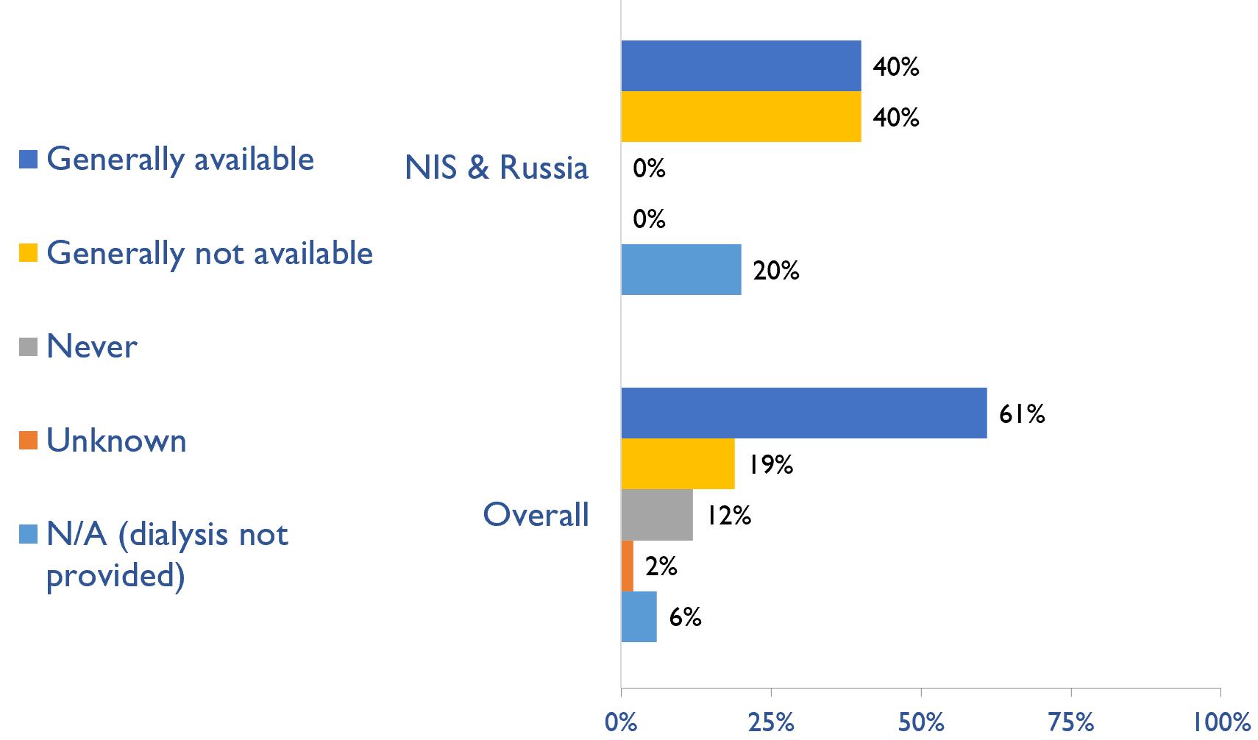
Availability of services within dialysis care
HD frequency
Country | HD frequency a center-based service that involves treatment 3x week/3-4x hours |  |  |  |  | PD frequency ability to do adequate exchanges 3-4x day (or equivalent cycles on automated PD)
 | Generally available | Generally not available | Never | Unknown | N/A (dialysis not provided) | Generally available | Generally not available | Never | Unknown | N/A (dialysis not provided)
Armenia | X |  |  |  |  |  |  |  |  | X
Azerbaijan | X |  |  |  |  |  | X
Belarus | X |  |  |  |  | X
Georgia | X |  |  |  |  | X
Kazakhstan | X |  |  |  |  | X
Kyrgyz Republic | X |  |  |  |  |  | X
Russian Federation | X |  |  |  |  |  | X
Tajikistan | X |  |  |  |  |  | X
Ukraine | X |  |  |  |  | X
Uzbekistan | X |  |  |  |  |  |  |  |  | X
PD frequency
X : Yes

Slide 29
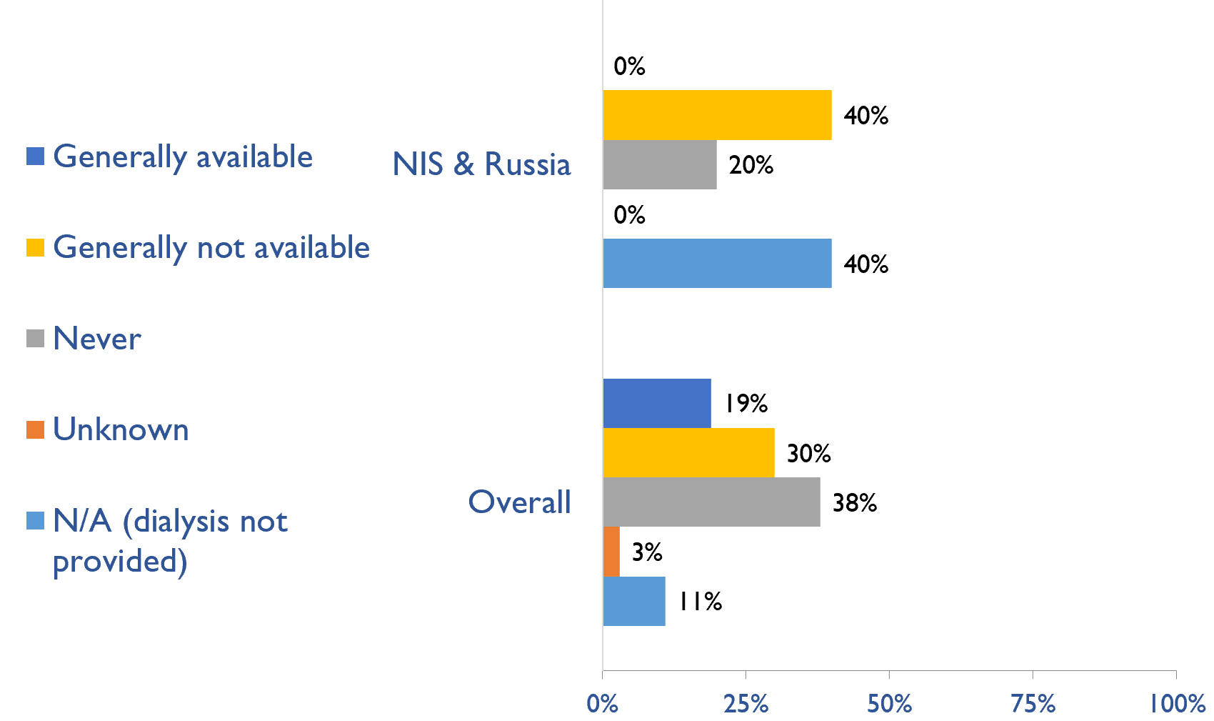
Availability of Home hemodialysis
Country | Availability of Home hemodialysis
 | Generally available | Generally not available | Never | Unknown | N/A (dialysis not provided)
Armenia |  |  |  |  | X
Azerbaijan |  |  | X
Belarus |  |  | X
Georgia |  | X
Kazakhstan |  | X
Kyrgyz Republic |  |  |  |  | X
Russian Federation |  |  |  |  | X
Tajikistan |  | X
Ukraine |  | X
Uzbekistan |  |  |  |  | X
X : Yes

Slide 30
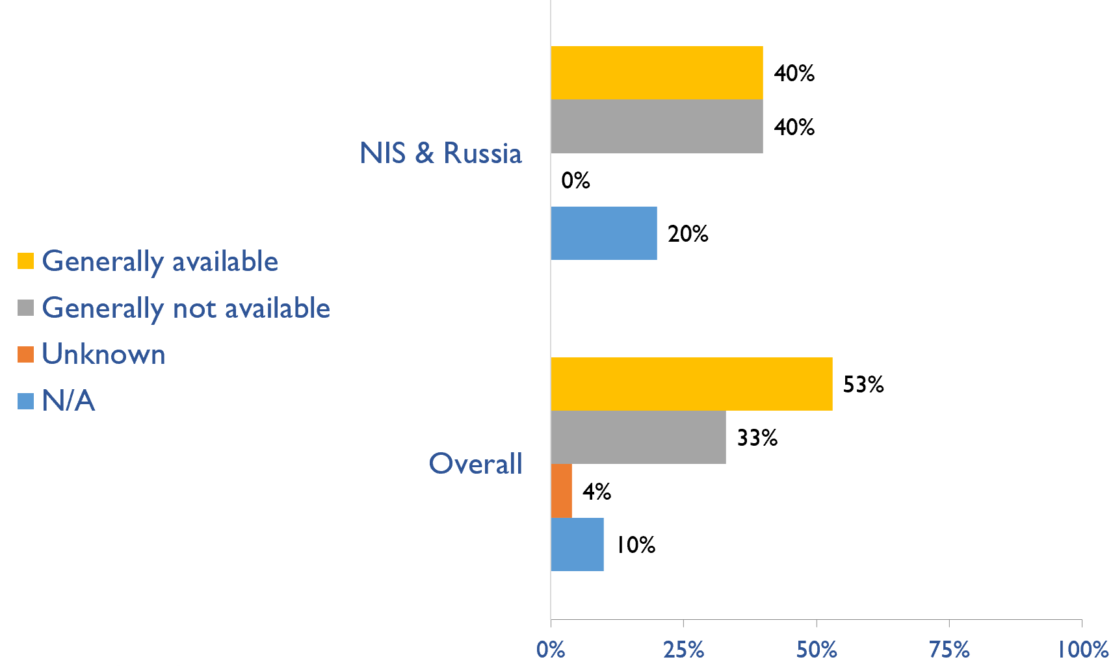
Capacity for conservative kidney management (CKM)
Country | Established conservative care that is chosen or medically advised
 | Generally available | Generally not available | Unknown | N/A (conservative care not available)
Armenia |  |  |  | X
Azerbaijan |  | X
Belarus | X
Georgia |  |  |  | X
Kazakhstan |  | X
Kyrgyz Republic | X
Russian Federation |  | X
Tajikistan | X
Ukraine | X
Uzbekistan |  | X
X : Yes

Slide 31
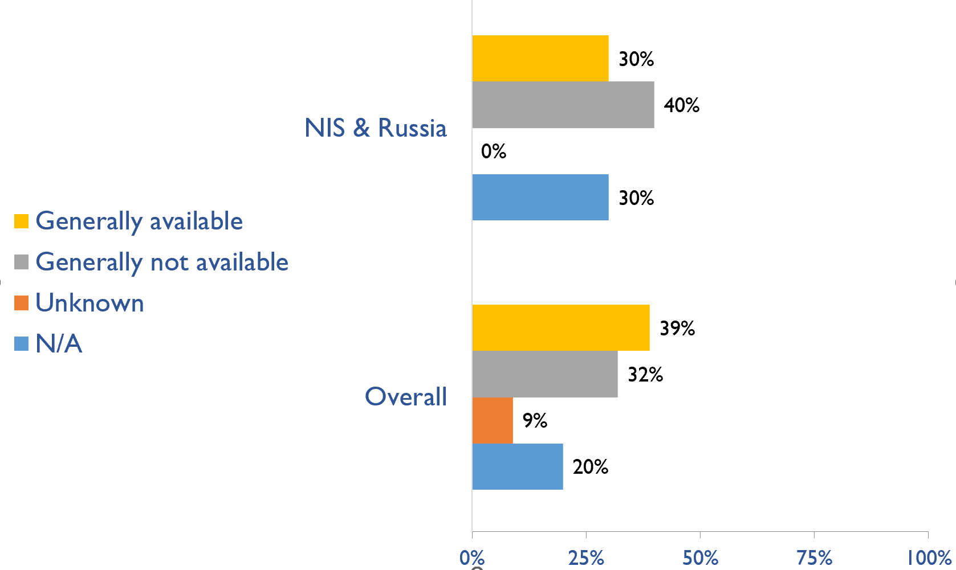
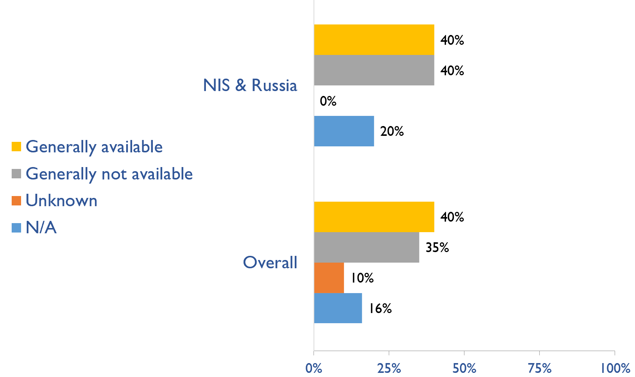
Capacity for conservative kidney management (CKM)
Where resource constraints to prevent or limit access to KRT
Country | where resource constraints to prevent or limit access to KRT |  |  |  | where there are no resource constraints to prevent or limit access to KRT
 | Generally available | Generally not available | Unknown | N/A (conservative care not available) | Generally available | Generally not available | Unknown | N/A (conservative care not available)
Armenia |  |  |  | X |  |  |  | X
Azerbaijan |  | X |  |  |  | X
Belarus |  |  |  | X |  | X
Georgia |  |  |  | X |  |  |  | X
Kazakhstan |  | X |  |  |  | X
Kyrgyz Republic | X |  |  |  | X
Russian Federation |  | X |  |  |  | X
Tajikistan | X |  |  |  | X
Ukraine | X |  |  |  | X
Uzbekistan |  | X |  |  | X
Where there are no resource constraints to prevent or limit access to KRT
X : Yes

Slide 32
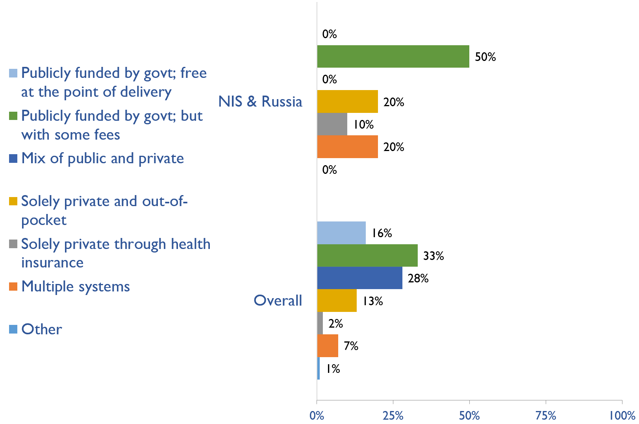
Funding for medications in CKD patients not on dialysis
Country | Publicly funded by govt; free at the point of delivery | Publicly funded by govt but with some fees at the point of delivery | Mix of public and private funding systems | Solely private and out-of-pocket | Solely private through health insurance providers | Multiple systems | Other
Armenia |  |  |  |  |  | X
Azerbaijan |  |  |  | X
Belarus |  | X
Georgia |  |  |  |  | X
Kazakhstan |  | X
Kyrgyz Republic |  |  |  | X
Russian Federation |  |  |  |  |  | X
Tajikistan |  | X
Ukraine |  | X
Uzbekistan |  | X
X : Yes

Slide 33
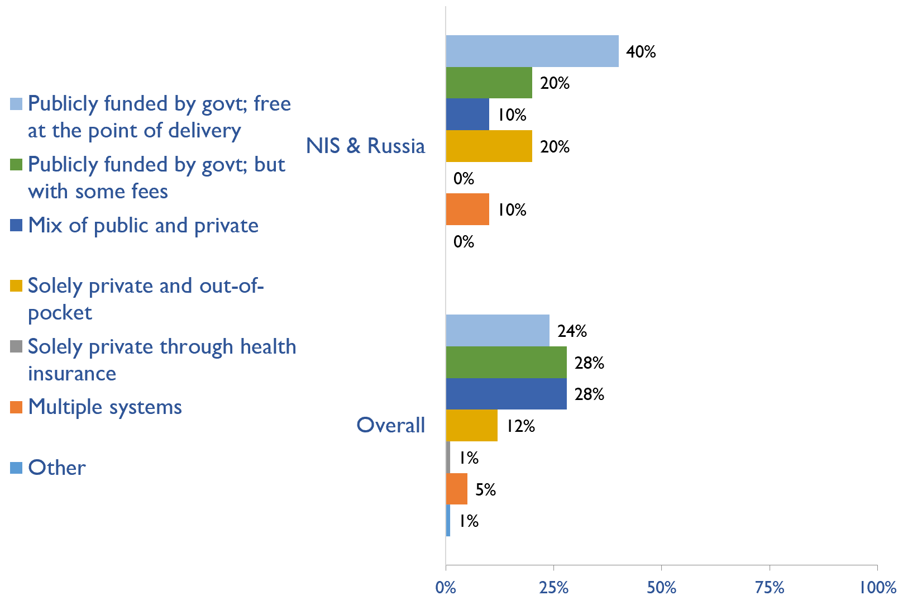
Funding for medications in all dialysis patients
Country | Publicly funded by govt; free at the point of delivery | Publicly funded by govt but with some fees at the point of delivery | Mix of public and private funding systems | Solely private and out-of-pocket | Solely private through health insurance providers | Multiple systems | Other
Armenia |  |  |  | X
Azerbaijan | X
Belarus | X
Georgia |  | X
Kazakhstan | X
Kyrgyz Republic |  |  | X
Russian Federation |  |  |  |  |  | X
Tajikistan |  |  |  | X
Ukraine |  | X
Uzbekistan | X
X : Yes

Slide 34
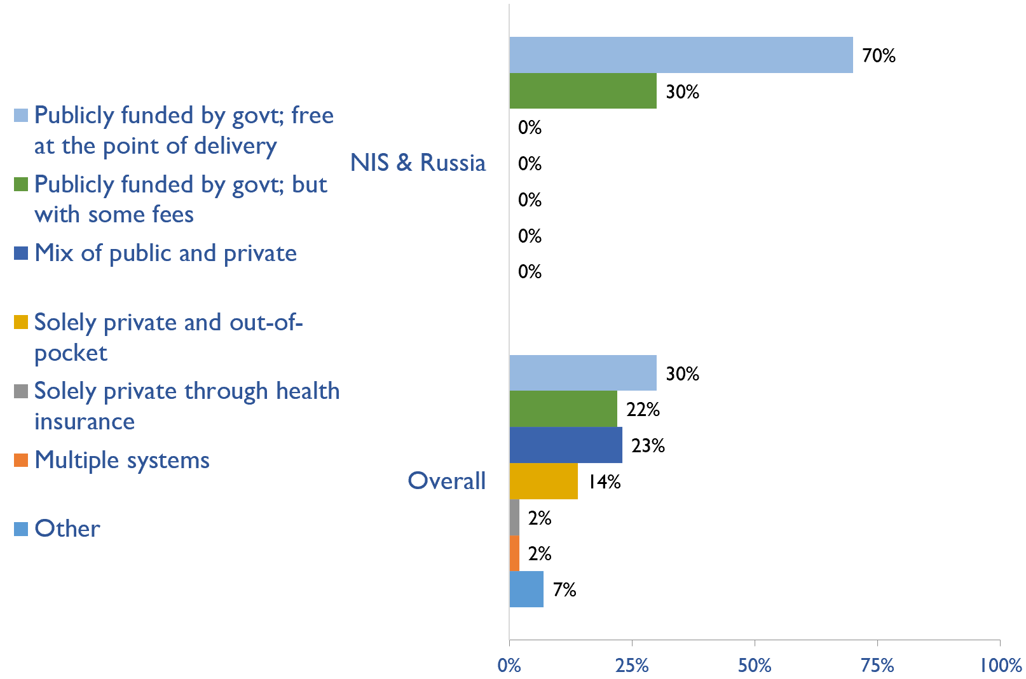
Funding for medications in all transplant patients
Country | Publicly funded by govt; free at the point of delivery | Publicly funded by govt but with some fees at the point of delivery | Mix of public and private funding systems | Solely private and out-of-pocket | Solely private through health insurance providers | Multiple systems | Other
Armenia | X
Azerbaijan |  | X
Belarus | X
Georgia | X
Kazakhstan | X
Kyrgyz Republic | X
Russian Federation | X
Tajikistan |  | X
Ukraine |  | X
Uzbekistan | X
X : Yes

Slide 35
Availability of official registry
Country | CKD | Dialysis | Transplant | AKI | Conservative care
Armenia |  |  | X
Azerbaijan |  | X | X
Belarus |  | X | X | X
Georgia |  | X | X
Kazakhstan |  | X | X
Kyrgyz Republic |  | X | X
Russian Federation |  | X | X
Tajikistan |  |  | X
Ukraine | X | X | X | X | X
Uzbekistan |  | X | X
X : Yes

Slide 36
Summary of Findings
In summary, the 2023 ISN-GKHA highlights several important findings for the NIS & Russia region.
KRT availability, access, and quality is high.
  HD services are available in all countries in the region. However, PD services were unavailable in Armenia, Tajikistan, and Uzbekistan
  Capacity to provide adequate frequency of HD i.e., three times weekly for 3 – 4 hours per session, was available in all countries in the region.
  Capacity to provide adequate PD exchanges i.e., three to four exchanges per day was available in 40% of countries.
  Home HD was unavailable in the region.
  KT centres are available in all countries in the region with a median prevalence of 0.27 pmp.
CKM is available and predominately chosen or medically advised.
  Conservative kidney management (CKM) established through shared-decision making was available in 40% of countries.
  Choice restricted CKM (where resource constraints prevent or limit access) was available in 30% of countries.
  Choice restricted CKM (where no resource constraints prevent or limit access) was also available in 40% of countries.
Government funding for kidney care services and medication is low.
  Reimbursement for medications that is free at point of delivery for ND-CKD, dialysis, and KT are available in 0%, 4 (40%), and in 7 (70%) countries, respectively.
  Reimbursement that is free for acute dialysis, chronic HD, and chronic PD were available in 5 (45.5%), 6 (54.5%), and 6 (54.5%) countries, respectively.

Slide 37
Summary of Findings (cont’d)
Most have registries for advanced kidney disease, few for CKD or AKI
  Availability of kidney registries varied across countries in the region.
  ND-CKD registry was available only in Ukraine; dialysis registries in 8 (80%), and KT registries are available in all countries (100%) in the region. Acute dialysis registries are available Belarus and Ukraine and only Ukraine reported having a CKM registry.
Many workforce limitations are present.
  The median prevalence of nephrologists was 9.8 pmp with the highest prevalence in Georgia (31.2 pmp) and the lowest in Tajikistan (3.5 pmp).
  The median prevalence of nephrology trainees in the region was 1.26 pmp and was highest in Georgia (3.2 pmp) and lowest in Ukraine (0.34 pmp).
  The region reported critical shortages of nephrologists (70%), dietitians (90%), counsellors (70%), transplant coordinators (70%), social workers (90%), palliative care physicians (70%), and kidney supportive care nurses (80%).
Moderate advocacy for kidney disease in the NIS and Russia.
  Advocacy groups for CKD, kidney failure and KRT remains low in the region.

Slide 38
Implications
There are important implications to consider. Based on these survey findings, key recommendations to drive future activities for optimizing kidney care globally are proposed:
Increase health care financing for kidney failure prevention and management.
  While resource limitations are an obvious barrier, focusing on preventing kidney failure through appropriate hypertension and diabetes management may be more cost-effective overall. Government funding to cover medication costs may allow more patients to treat earlier stage CKD, thereby preventing the need for more costly kidney failure treatment and the obvious burden this has on patients’ wellbeing.
Address workforce shortages through multidisciplinary teams and telemedicine
  Shortages of nephrologists, surgeons, dialysis nurses, and other key allied health professionals were noted across most countries. Similarly, simply producing more nephrologists may not be feasible or appropriate, and sharing the workload across multiple providers will not only promote the use of multidisciplinary teams but further, allow for more and better care delivery across more patients. Telemedicine may help particularly in addressing gaps in care among rural patients and enhancing capacity through training programs such as ISN Fellowship, visiting ambassador programs, etc.

Slide 39
Implications (cont’d)
Incorporate the collection and reporting of quality indicators in kidney failure care.
  Measuring and reporting on key quality indicators is an important driver in healthcare improvement. Ensuring facilities are supported with information systems that allow for the systematic measurement and reporting of indicators is a first key step to increasing the rate of monitoring among countries. Further, understanding if or how the collection and reporting of indicators are being used to improve care is needed.
Expand health information systems to prevent and manage kidney failure.
  Similarly, good quality HIS are vital for kidney disease management within a country. A lack of data on disease prevalence, incidence, resource use, and quality of care limits government and provider ability to monitor and evaluate the care provided as well as predicts appropriate resource allocation so that sufficient facilities, medicines, and healthcare professionals are trained and available.
Promote kidney failure prevention and treatment by implementing policies, strategies, and advocacy, and mitigating barriers.
  Lastly, policies and strategies are important for consistent approaches within a country for optimal care delivery, as well as for accountability, leadership, and knowledge exchange. Advocacy may help promote the increase of government prioritization and further, public awareness of how to prevent and manage kidney disease. Without acknowledging and mitigating barriers, it would be a challenge to achieve of successes out of these recommendations. Competing priorities and needs (for example, clean water supply and basic sanitation, maternal and child health, malnutrition, etc.) represent formidable barriers that can limit implementation of the recommended strategies in the region.

Slide 40







www.theisn.org
Global Operations Center
Americas Operations Center
Avenue des Arts 1-2
1210 Brussels, Belgium
340 North Avenue 3rd Floor
Cranford, NJ 07016-2496, United States
+ 32 2 808 04 20
+1 904 345 0866
info@theisn.org
info@theisn.org
Follow us

